Slide 1
Guided Capstone Project Report
Xin Shen

Slide 2
1.Problem Identification

Slide 3
1.Problem Identification
Big Mountain Resort is a ski resort in Montana. They recently installed additional chair lift to increase the distribution of visitors across the mountain but increases their operation costs by $1,540,000 this season. To increase the revenue and reduce the cost, the resort is considering either charging a premium above the average price or cutting costs.

Slide 4
2. Recommendation and Key Findings

Slide 5
2. Recommendation and Key Findings
Close only 1 least used run
Add a run
Increase the vertical drop by 150 feet
Install an additional chair lift

Slide 6
3. Modeling Results and Analysis

Slide 7
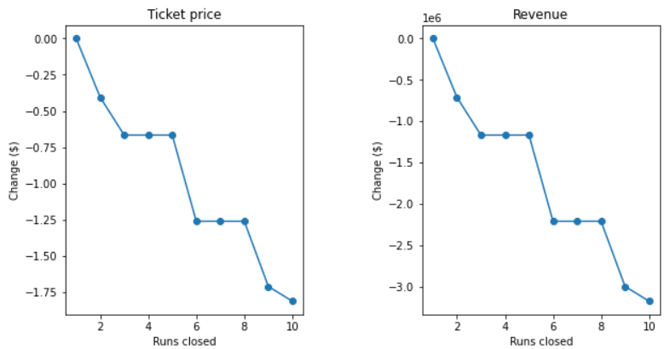
3. Modeling Results and Analysis
Scenario 1 : closing to 10 of the least used runs

Slide 8
Scenario 2 :
Add a run
Increase the vertical drop by 150 feet
Install an additional chair lift
Model Results:
Increases support for ticket price by $8.61

Slide 9
Scenario 3 :
Add a run
Increase the vertical drop by 150 feet
Install an additional chair lift
adding 2 acres of snow
Model Results:
Increases support for ticket price by $9.90

Slide 10
Scenario 4:
Increase the longest run by 0.2 miles
Guarantee its snow coverage by adding 4 acres of snow making capability
Model Results:
No influence

Slide 11
4. Summary and Conclusion

Slide 12
4. Summary and Conclusion
Price strategy is scenarios 1 and 2 are recommended. Closing 1 run does not influence the ticket price but can reduce the cost. And adding a run, increasing the vertical drop by 150 feet and installing an additional chair lift can support the ticket price significantly compared with other strategies.
But more detailed information about the operation cost in scenario 2 is required before it is finally adopted.

